Slide 1
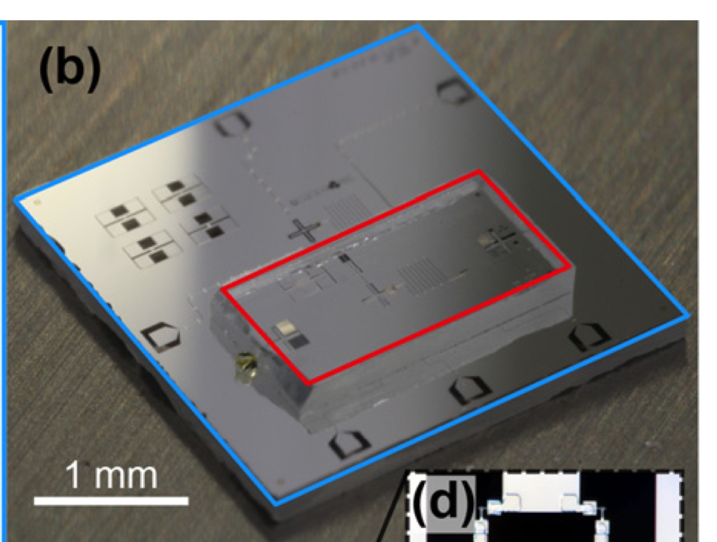
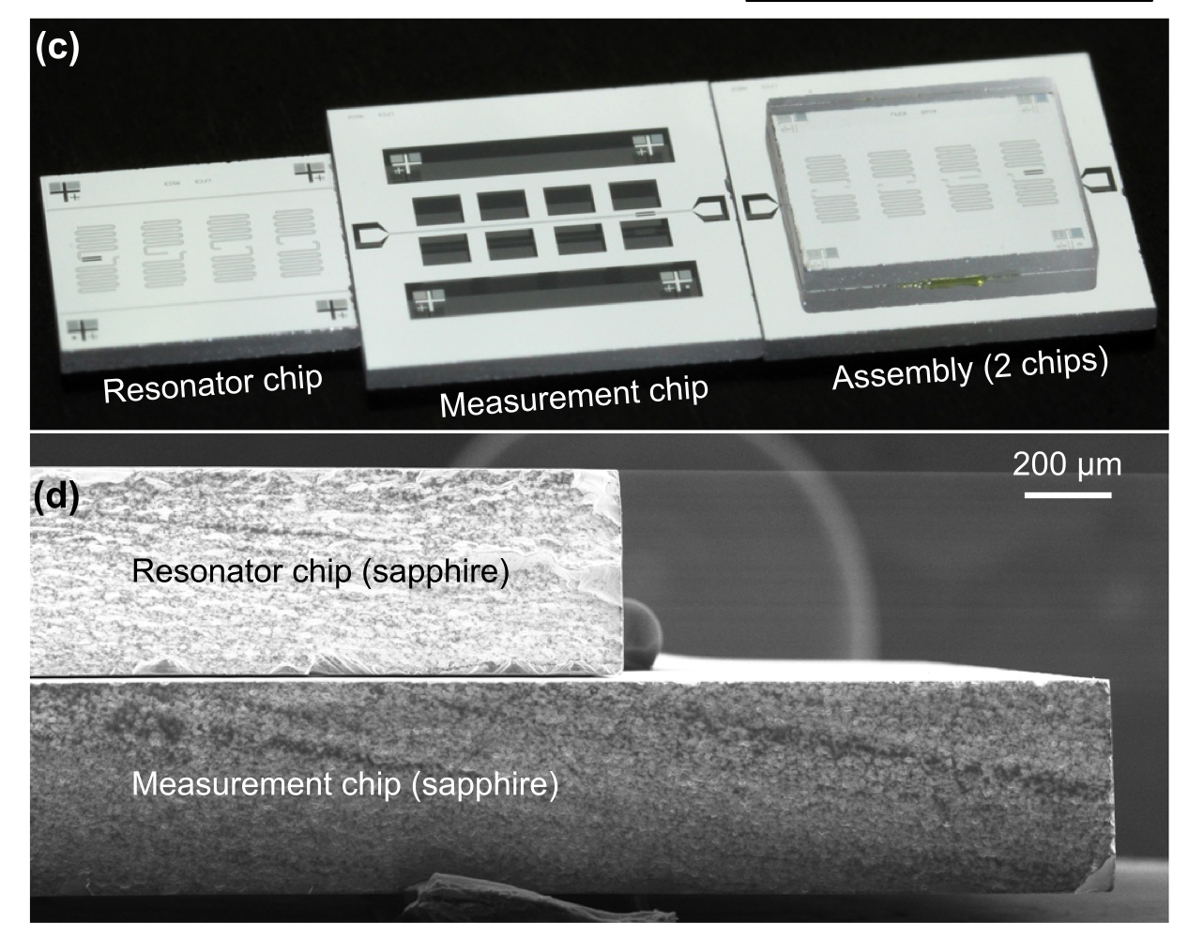
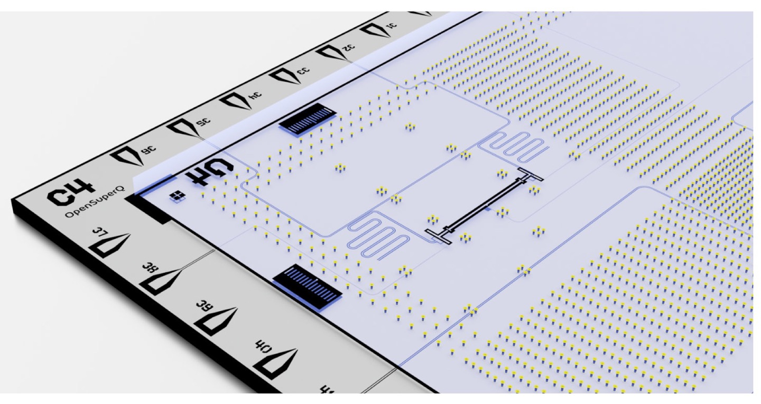
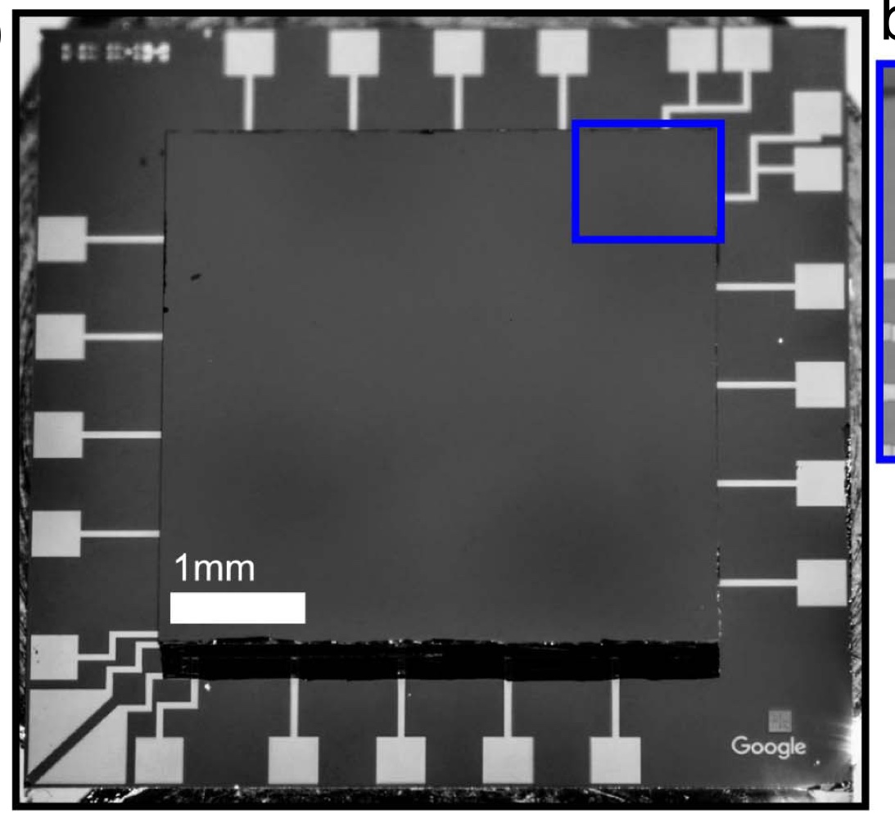
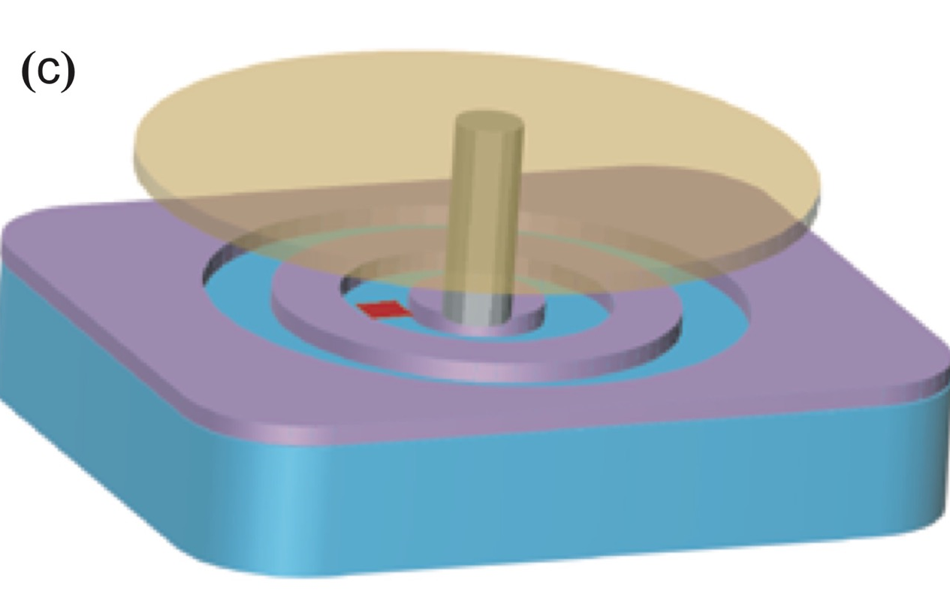
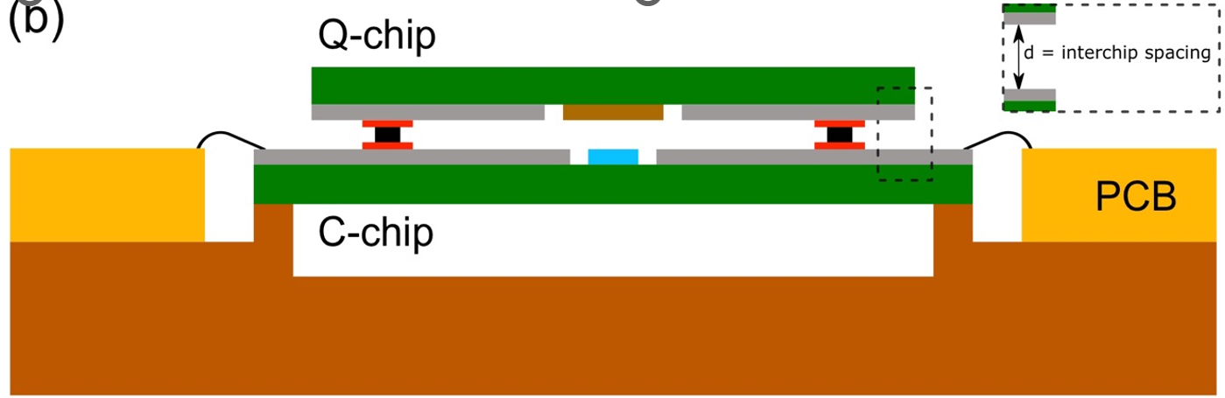
What is Flip-Chip
Bottom chip, Top chip can contain any component
Various chip size
Inductive, Capacitive, Galvanic coupling
Indium bump bonding/ PR Adhesion
C. R. Conner et al. Superconducting qubits in a flip-chip architecture. 2021.
D. I. Schuster et at. Simple non-galvanic flip-chip integration method for hybrid quantum systems. 2019.
Sandoko Kosen et al. Building Blocks of a Flip-Chip Integrated Superconducting
Quantum Processor. 2021.
Li X, Zhang Y, Yang C, Yu H. Vacuum-gap transmon qubits realized using flip-chip technology. 2021.
Foxen et al. Qubit compatible superconducting
interconnects. 2017.

Slide 2
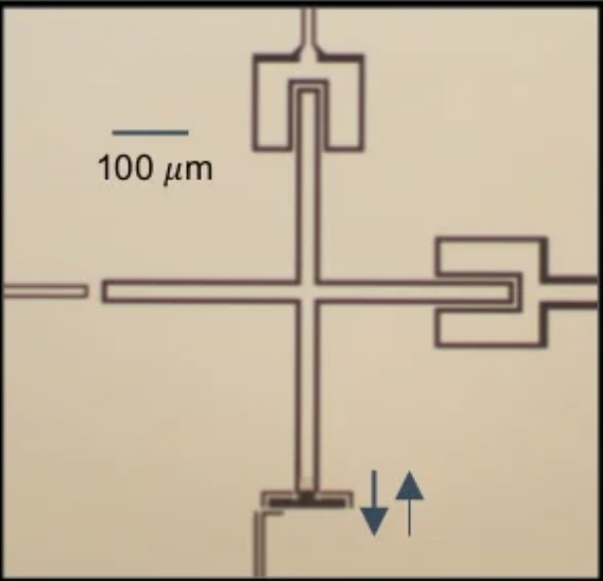
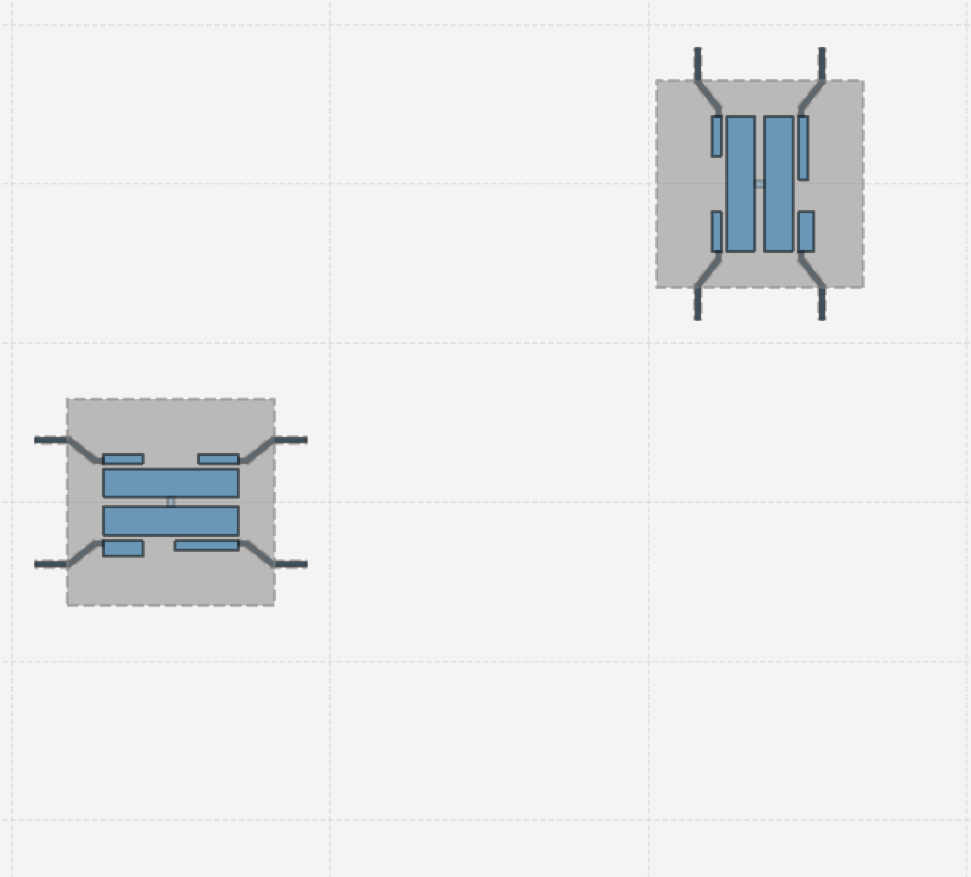
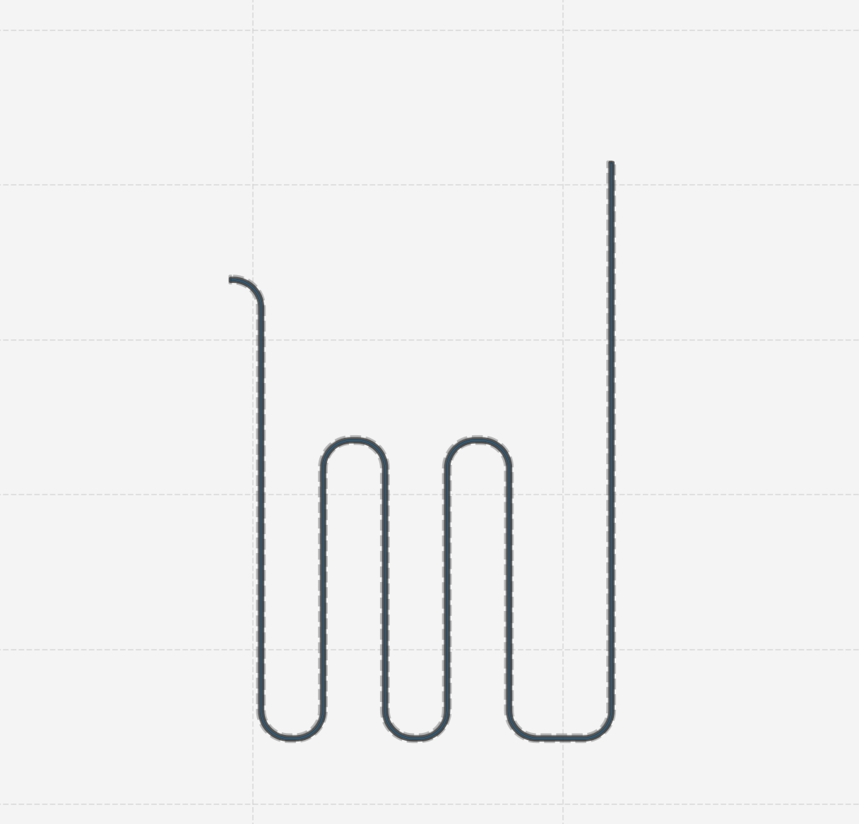
Why Filp-Chip
Complex Circuit → distribute components in different layer
Challenge of routing complex control wiring and readout circuitry
(e.g. Xmon : readout resonator, XY control, Z control, coupler)
2. Independent Fabrication A pristine qubit chip with only high coherence materials + A dense wiring chip that allows for lossy dielectrics. Integration of high-coherence qubit device with a dense, multi-layer, signal-routing device → hybrid device Integration of incompatible fabrication processes.
- Foxen B, Mutus JY, Lucero E, et al. Qubit compatible superconducting interconnects.

Slide 3
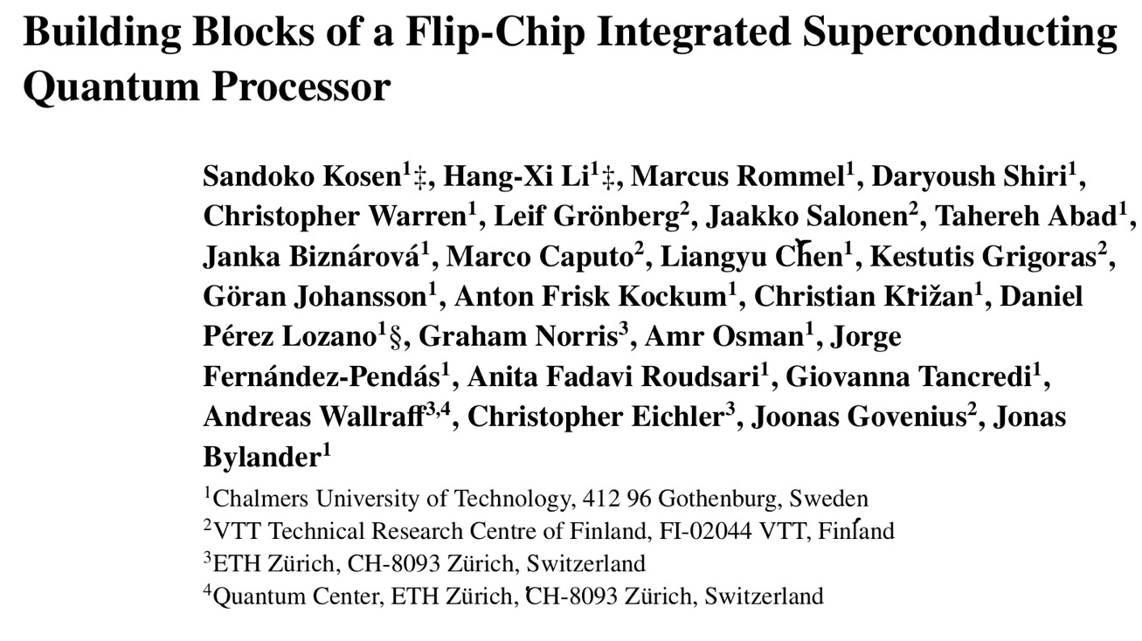
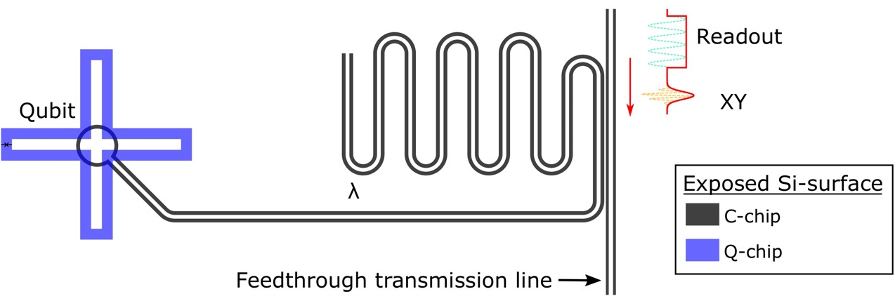
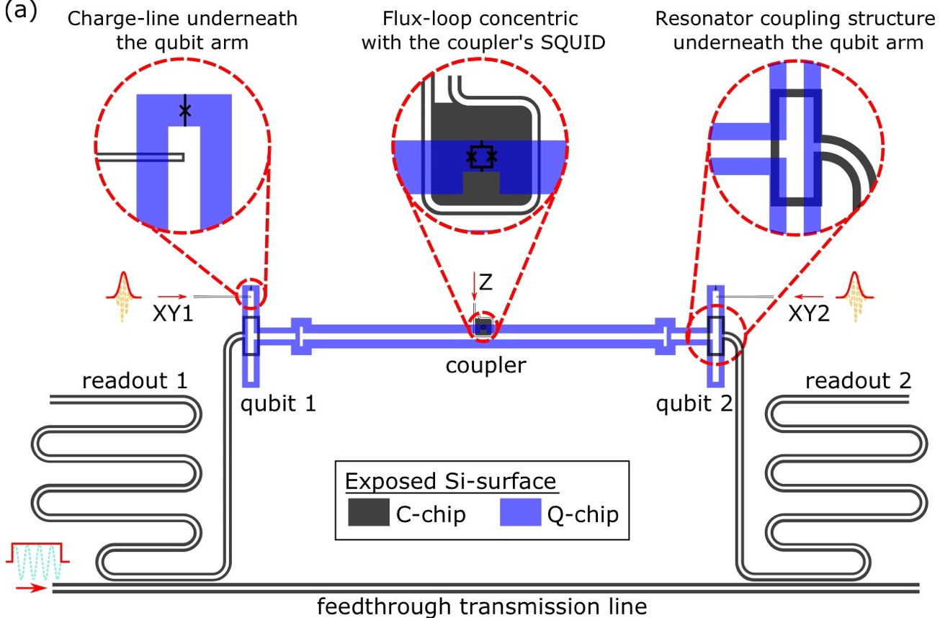
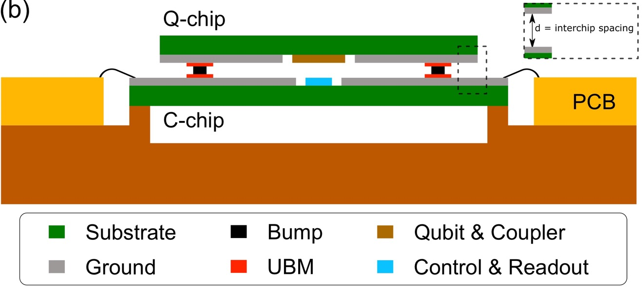
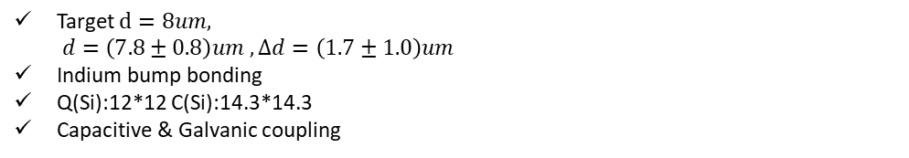
1 qubit
2 qubit
Target $d=8um,$ $d=\left(7.8±0.8\right)um , Δd=\left(1.7±1.0\right)um$
Indium bump bonding
Q(Si):12*12 C(Si):14.3*14.3
Capacitive & Galvanic coupling

Slide 4
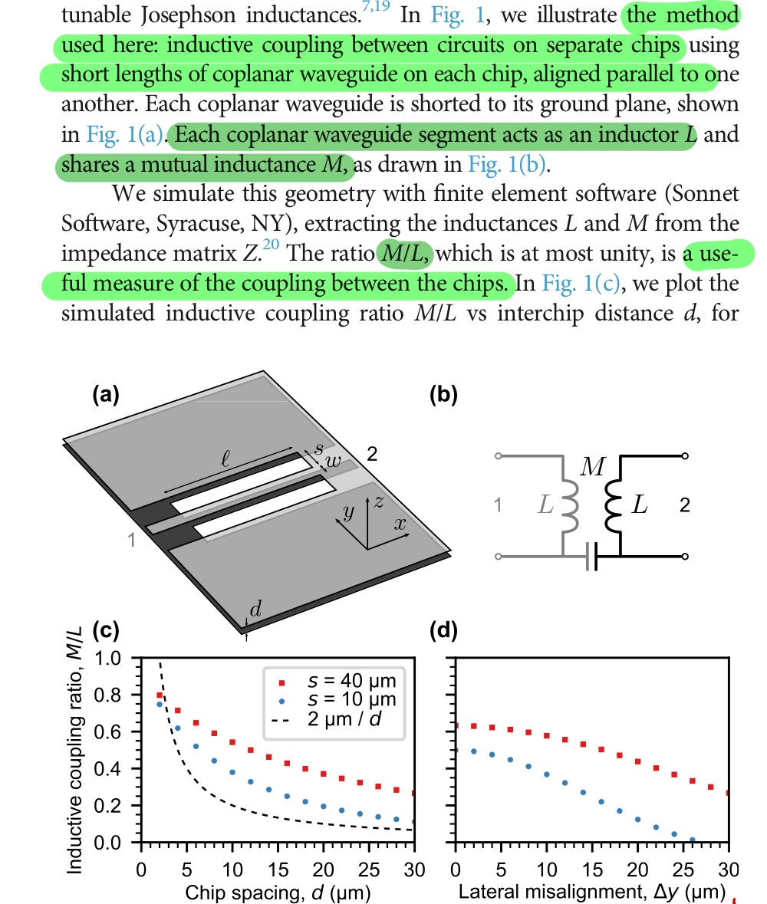
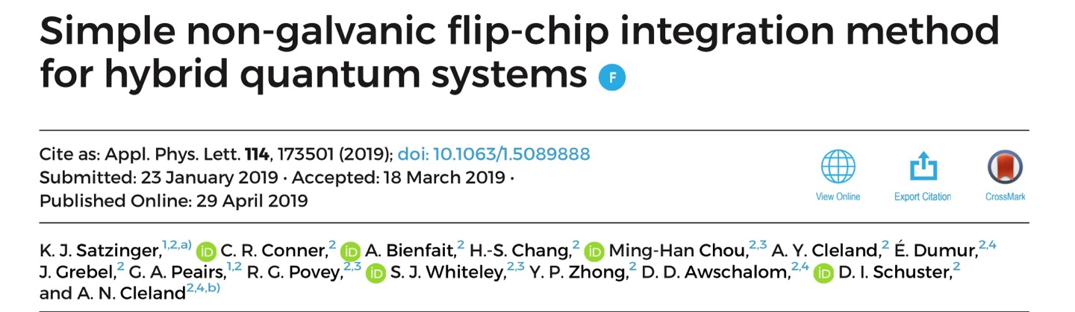
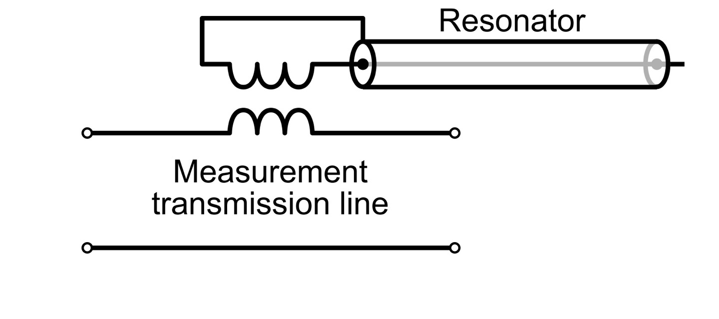
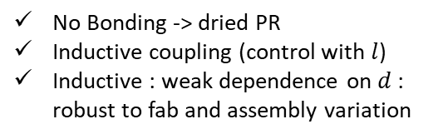
No Bonding -> dried PR
Inductive coupling (control with $l$)
Inductive : weak dependence on $d$ : robust to fab and assembly variation

Slide 5
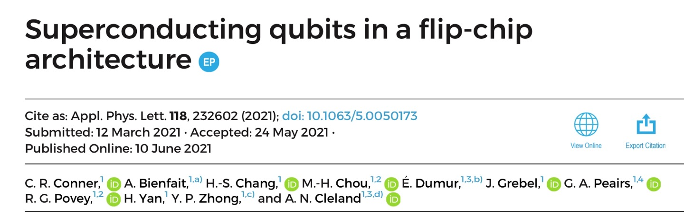
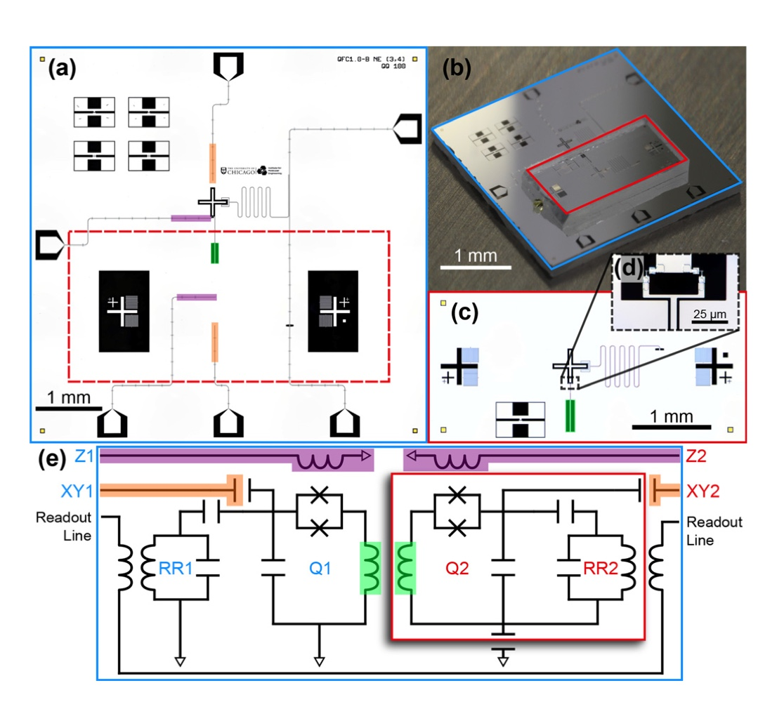
PR as an adhesive
Inductive & Capacitive & Galvanic

Slide 6
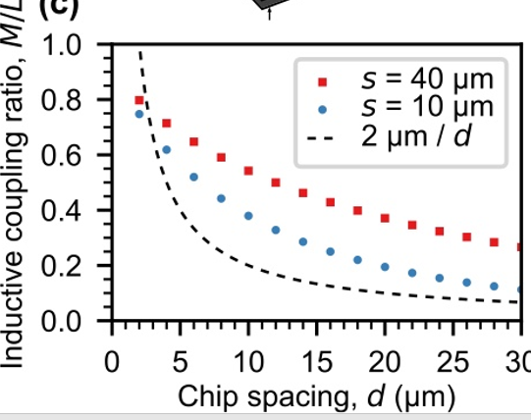
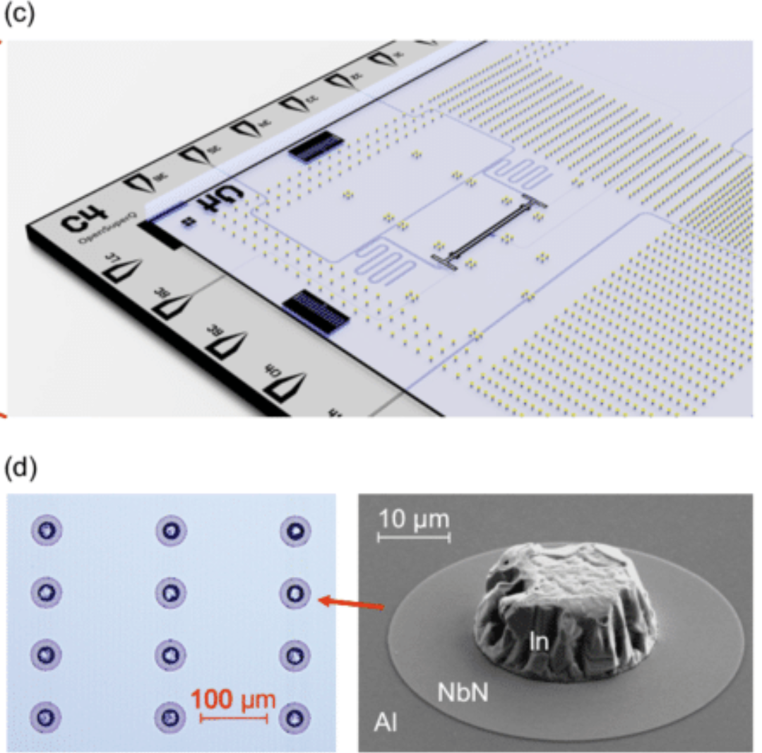
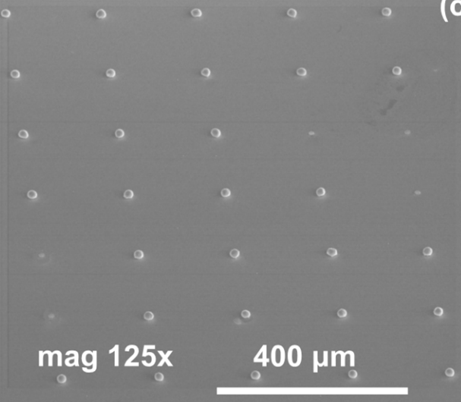
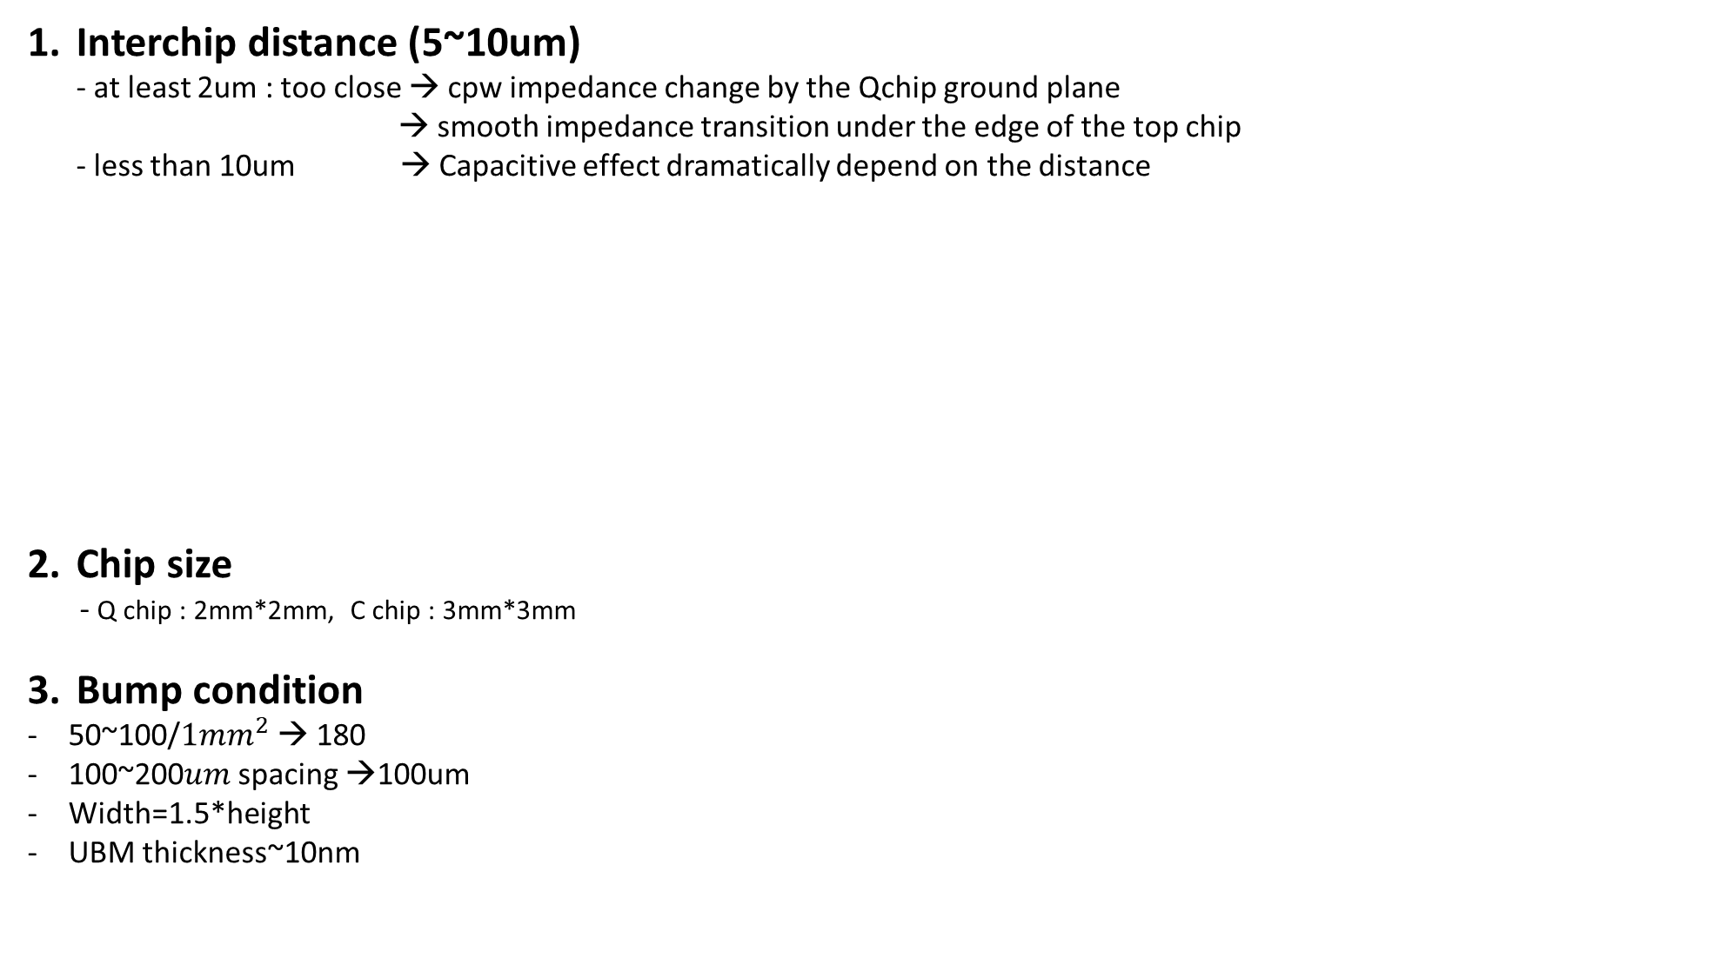
Interchip distance (5~10um) - at least 2um : too close → cpw impedance change by the Qchip ground plane → smooth impedance transition under the edge of the top chip - less than 10um → Capacitive effect dramatically depend on the distance
Chip size
- Q chip : 2mm*2mm, C chip : 3mm*3mm
Bump condition
50~100/$1mm^{2}$ → 180
100~200$um$ spacing →100um
Width=1.5*height
UBM thickness~10nm

Slide 7

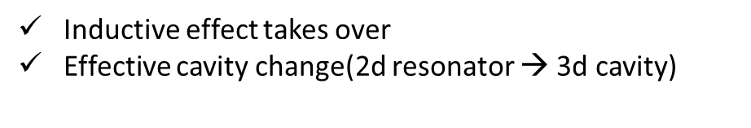
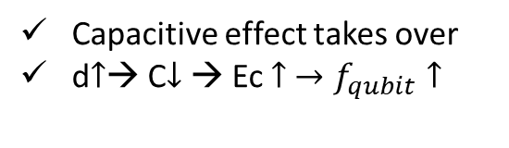
Planar chip qubit
Flip chip qubit : $d ∝f_{qubit}$
Capacitive effect takes over
d$↑$→ C$↓$ → Ec $↑ →f_{qubit}↑$
Qchip ground
Qchip ground
Qchip ground
qubit
qubit
qubit
qubit
Planar chip resonator
Flip chip resonator : $d^{−1}∝f_{res}$
Inductive effect takes over
Effective cavity change(2d resonator → 3d cavity)
Qchip ground
Qchip ground
Qchip ground
CPW
CPW
CPW
CPW
Qchip ground
CPW
CPW

Slide 8
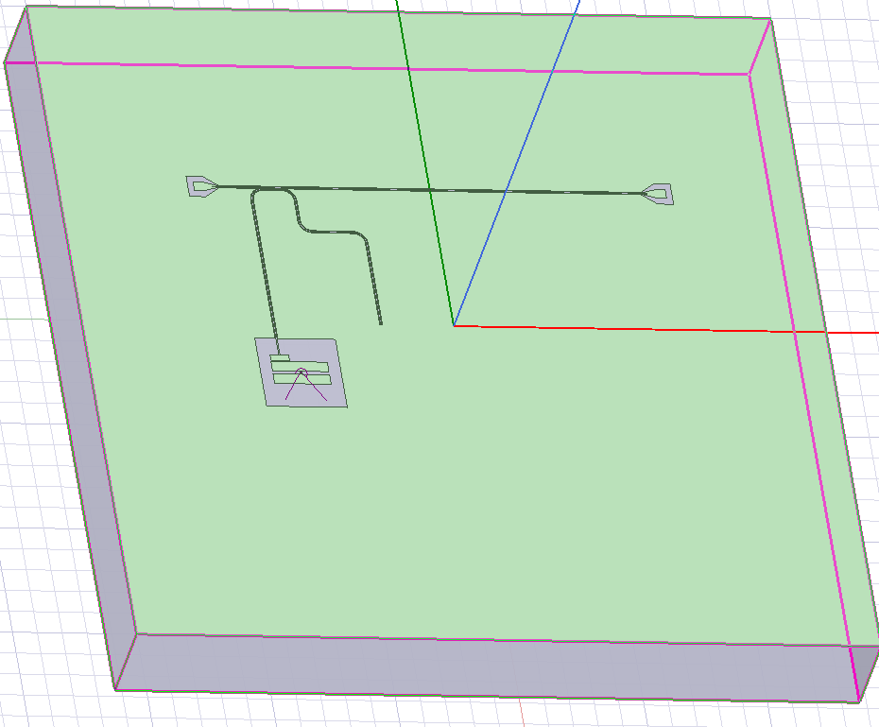
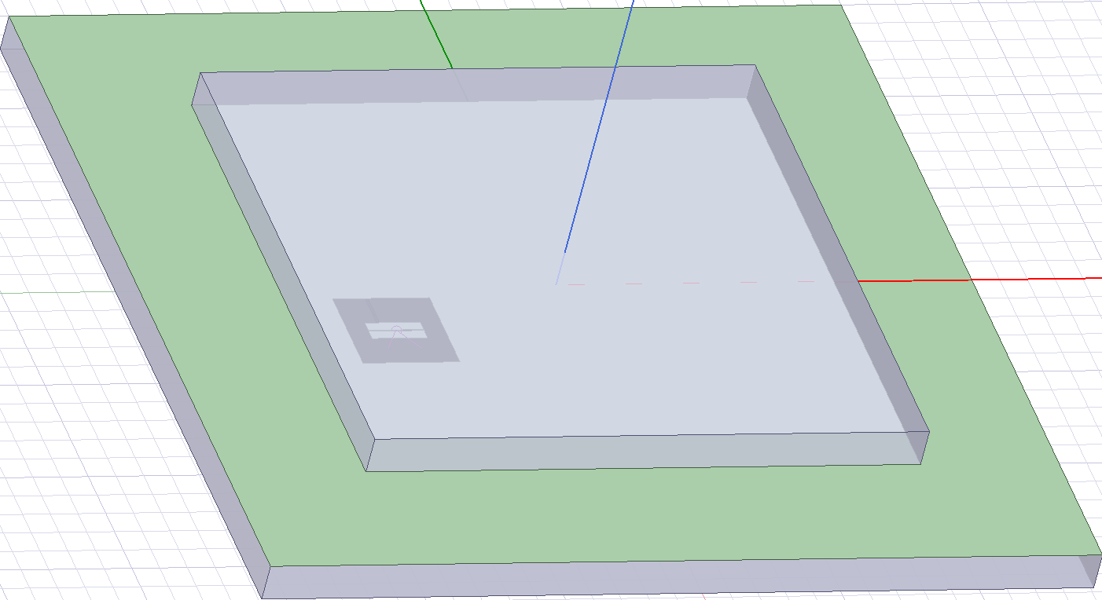
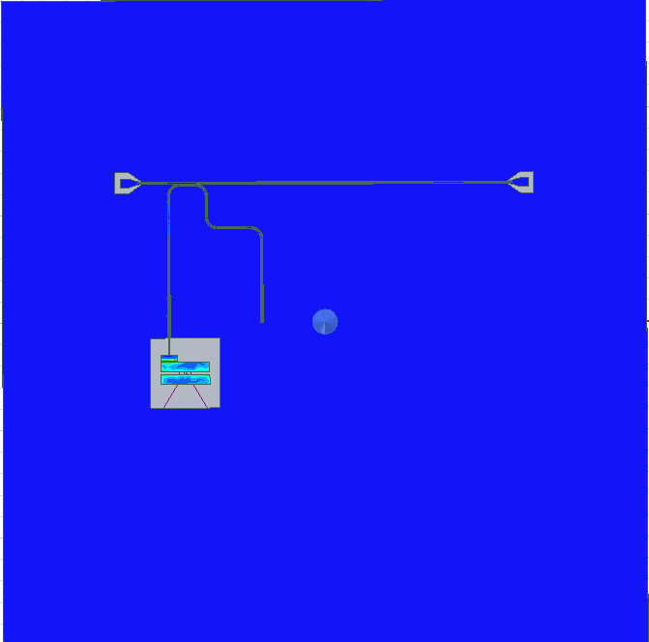
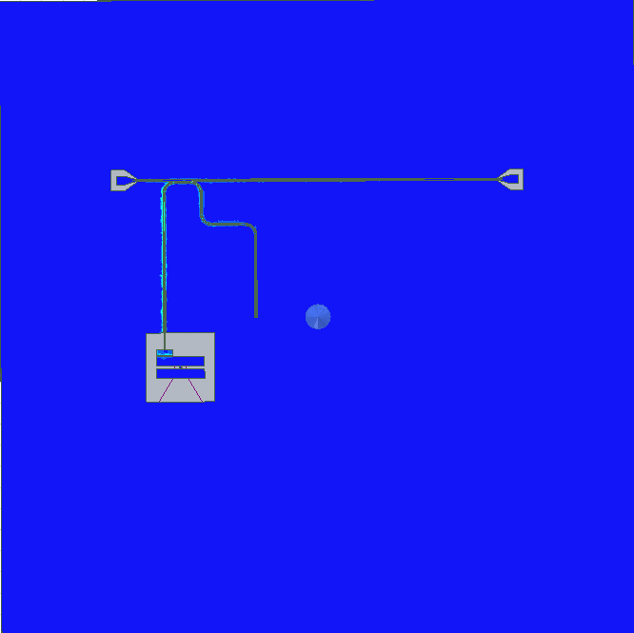
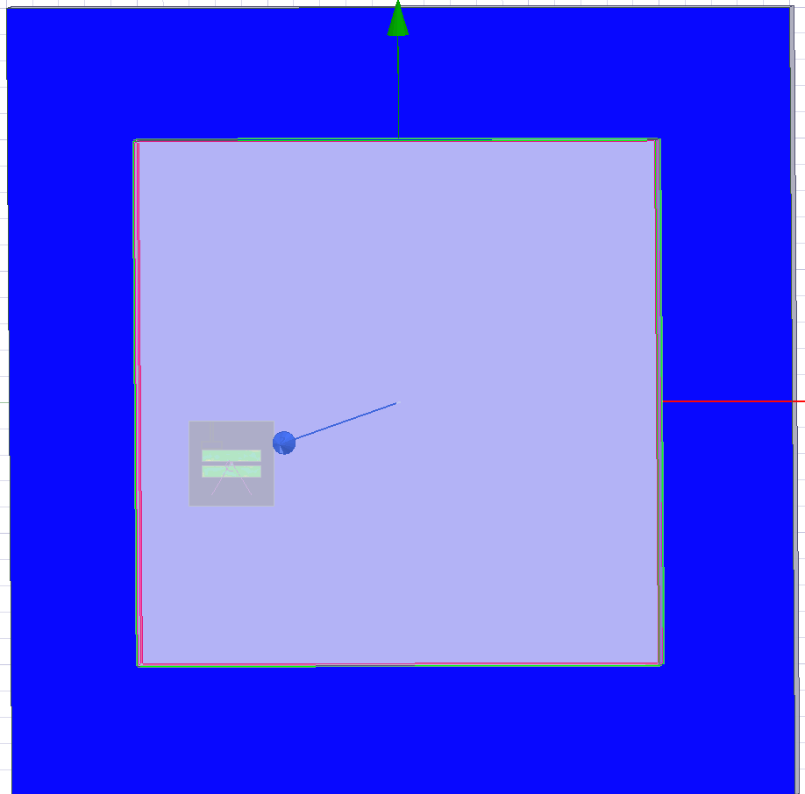
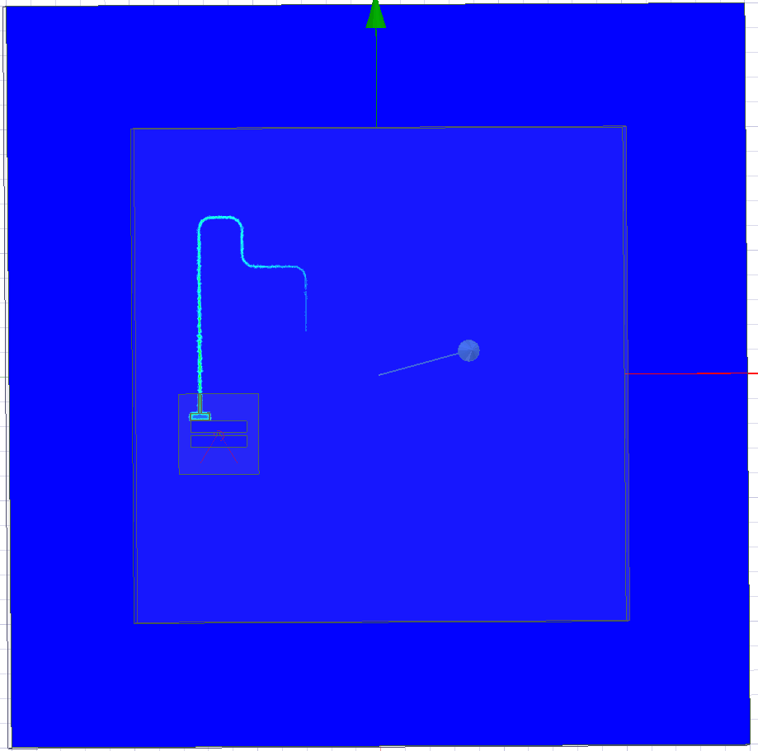
Planar chip : fq=5.83, fr=7.09, g=115
Flip chip(7um) : fq=5.09, fr=8.48, g=18
No Bump

Slide 9
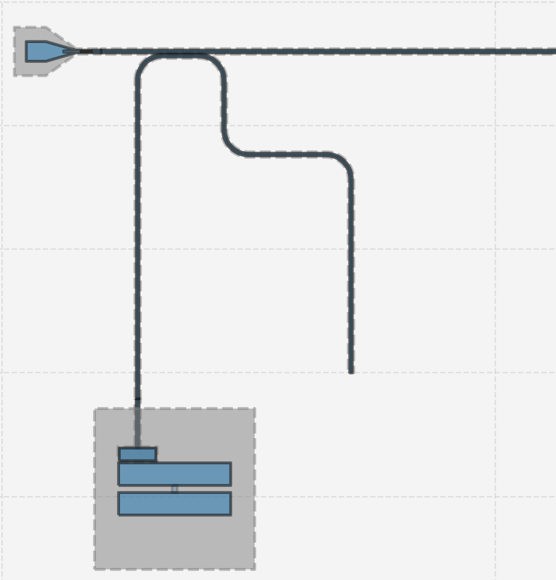
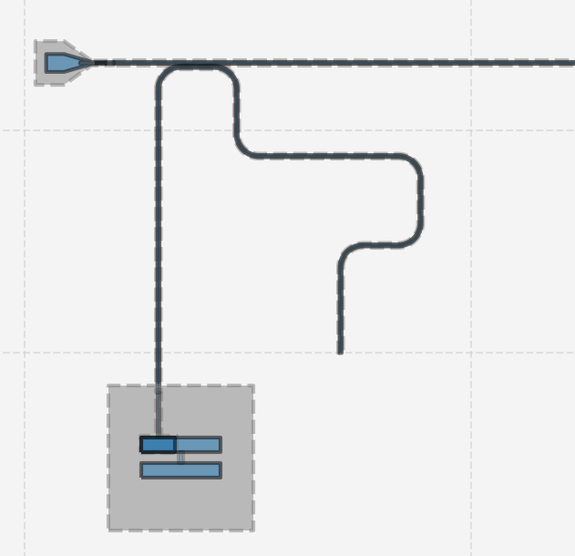
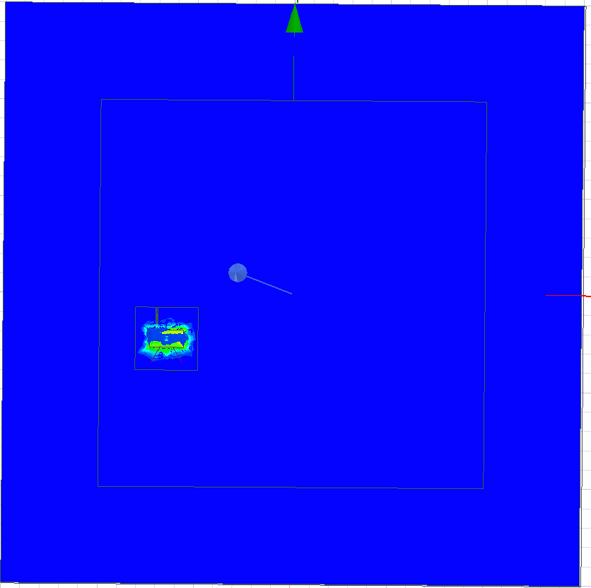
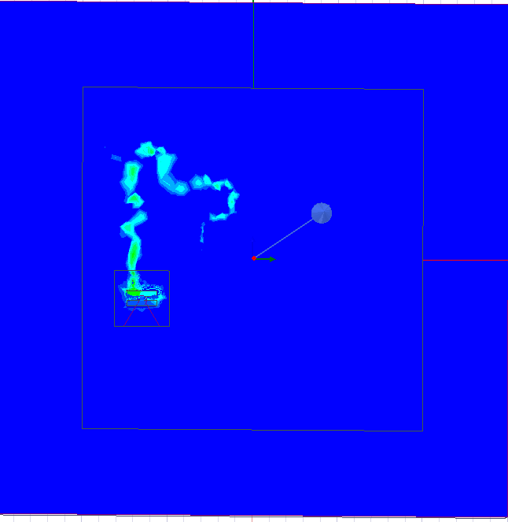
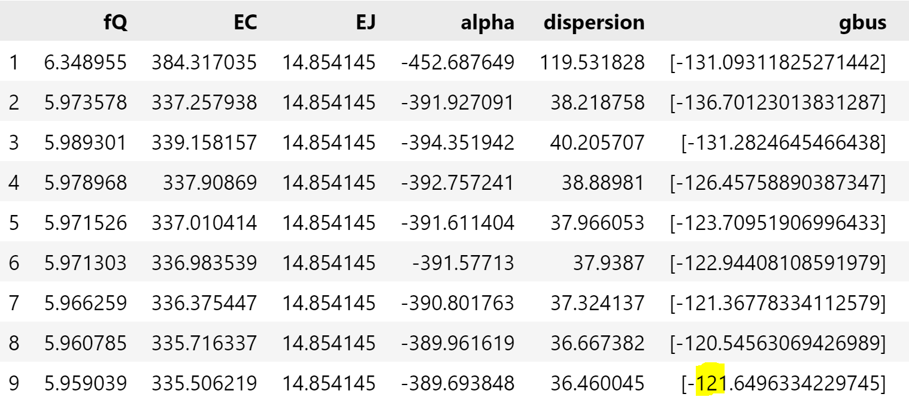
Flip chip(7um) : fq=5.88, fr=6.92, g=121
 | Qubit (GHz) | Resonator(GHz) | Coupling g (MHz)
Planar chip | 5.83 | 7.09 | 115
Flipchip_7um Planar design | 4.87 | 5.68 | 11
Flipchip_7um modification | 5.88 (0.8%) | 6.92 (2.3%) | 121 (5.21%)

Slide 10
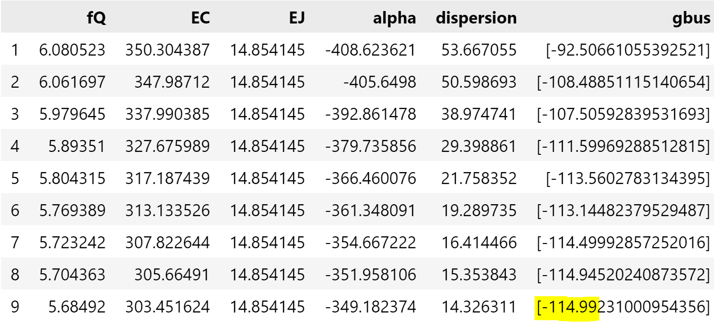
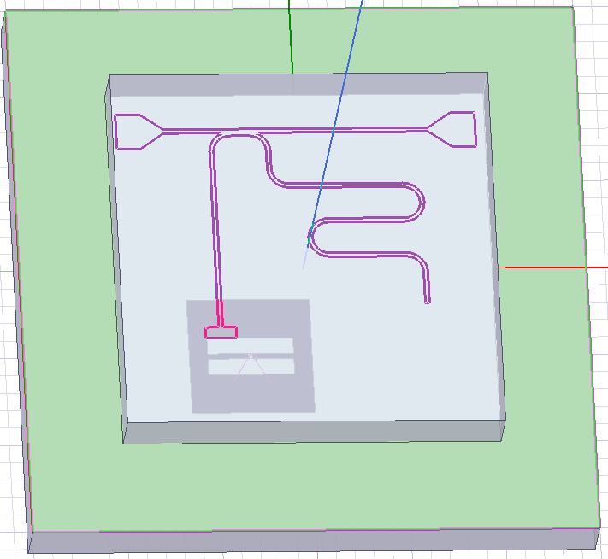
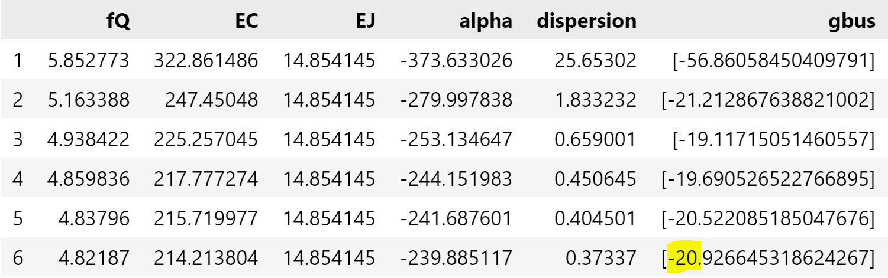
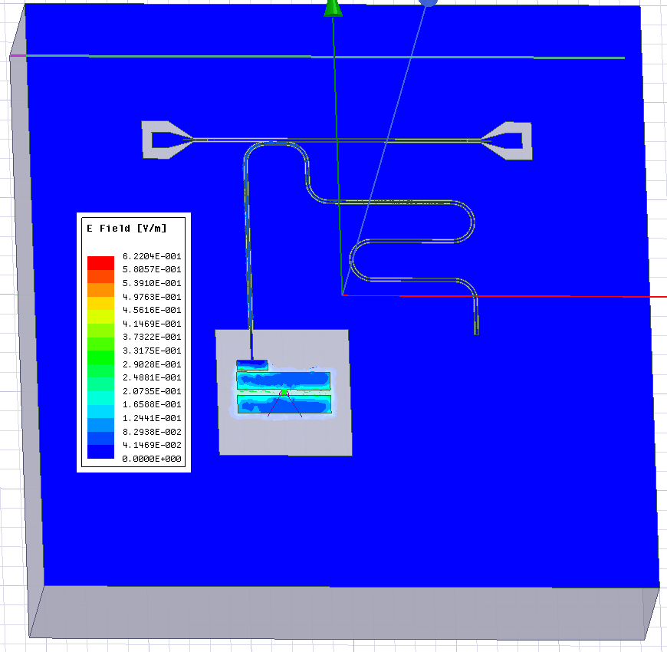
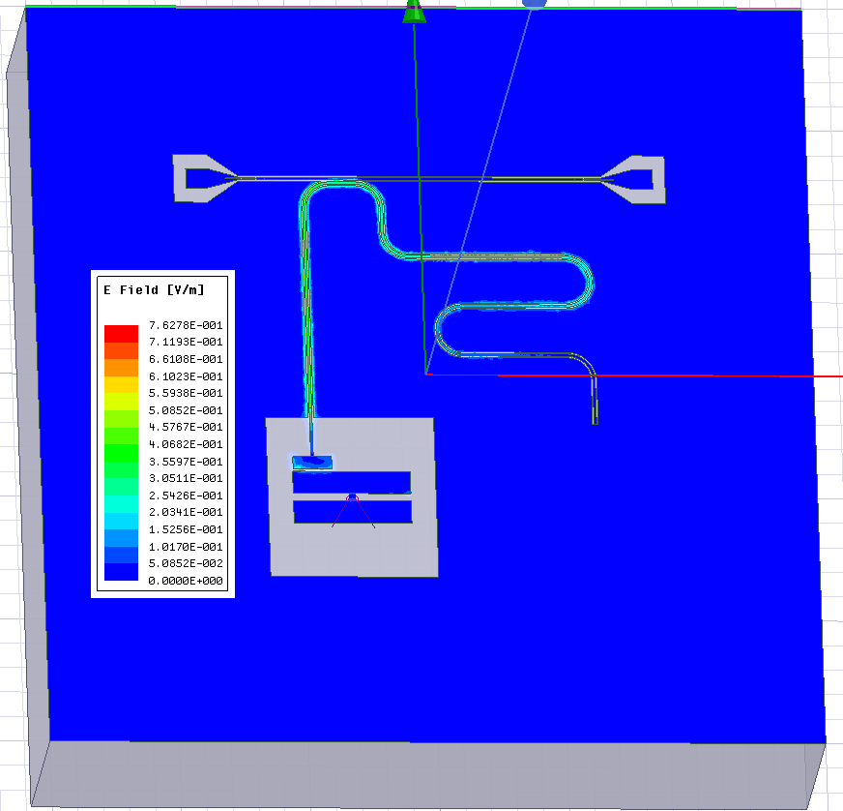
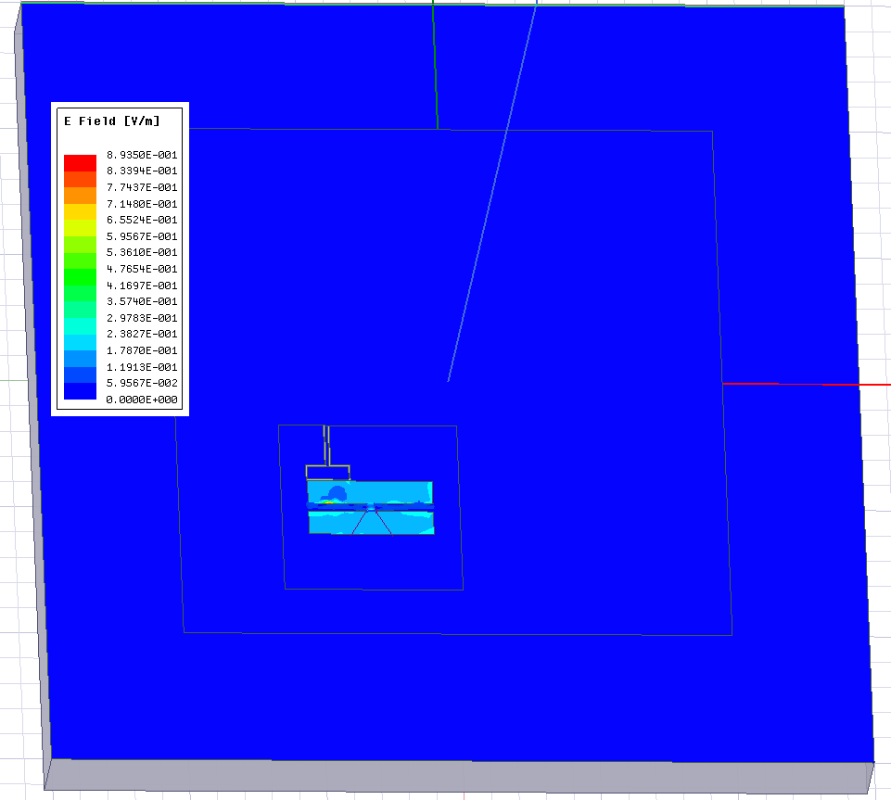
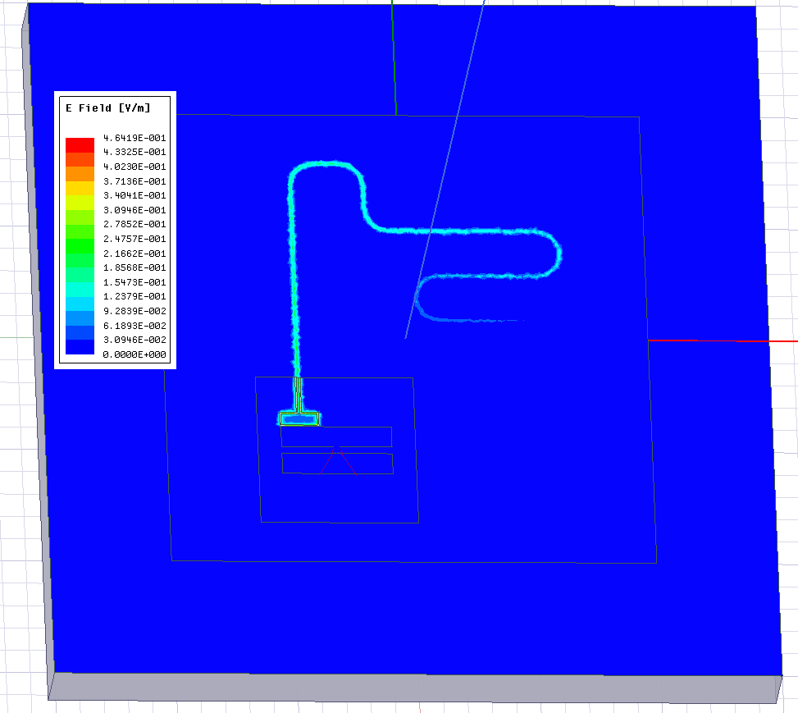

Planar chip : fq=5.81, fr=7.05, g=115
Flip chip(7um) : fq=4.78$↓$, fr=7.54$↑$, g=20
Qubit 5.81GHz
Resonator 7.05GHz
Qubit 4.87GHz
Resonator 7.54GHz

Slide 11
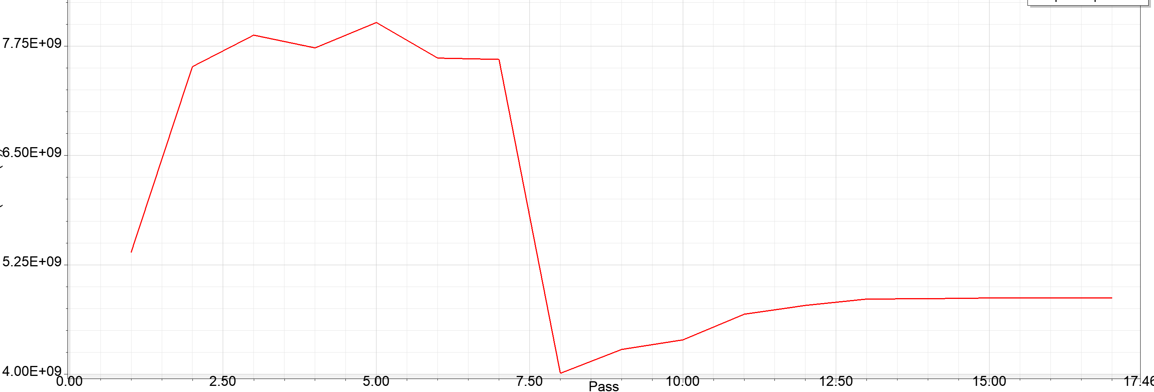
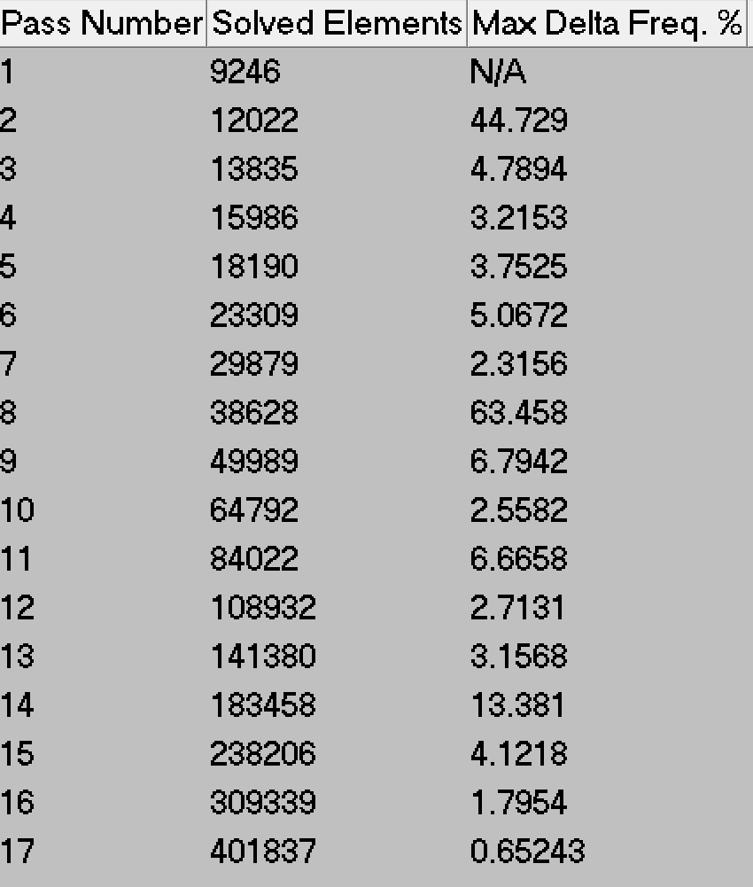
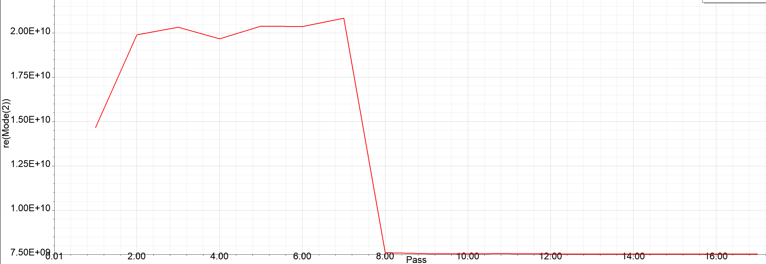
Simulation condition

Slide 12
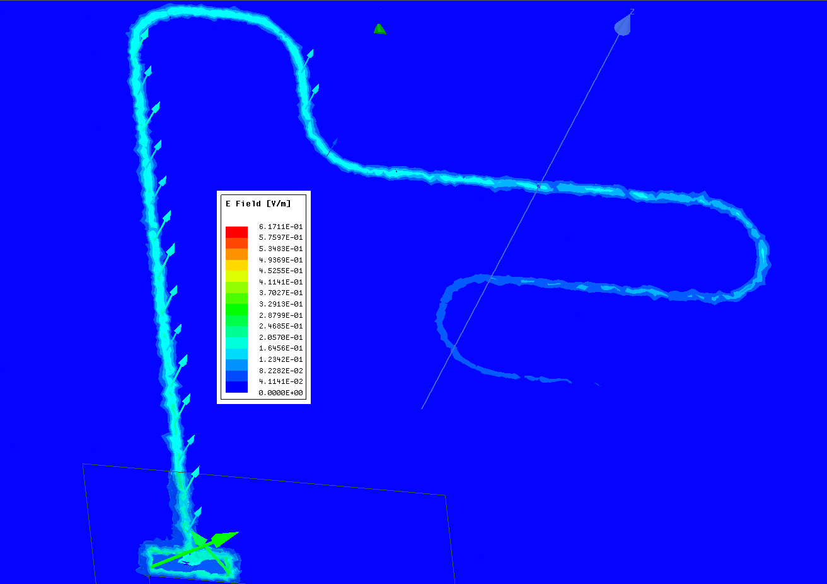
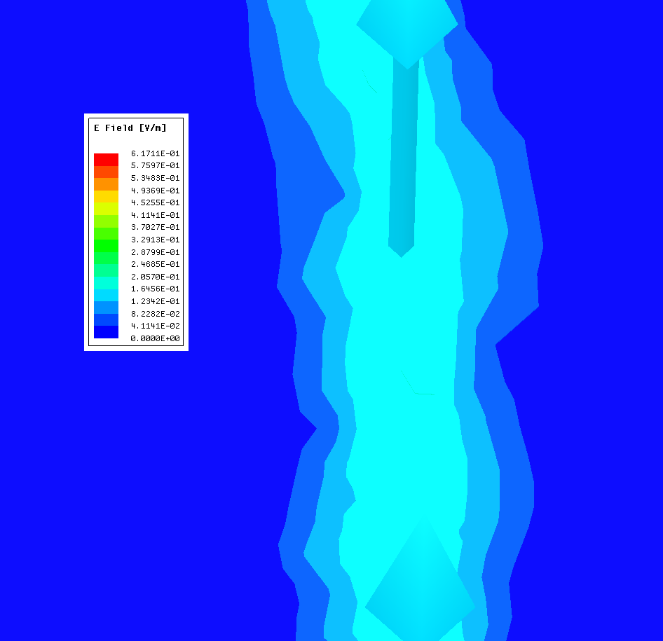
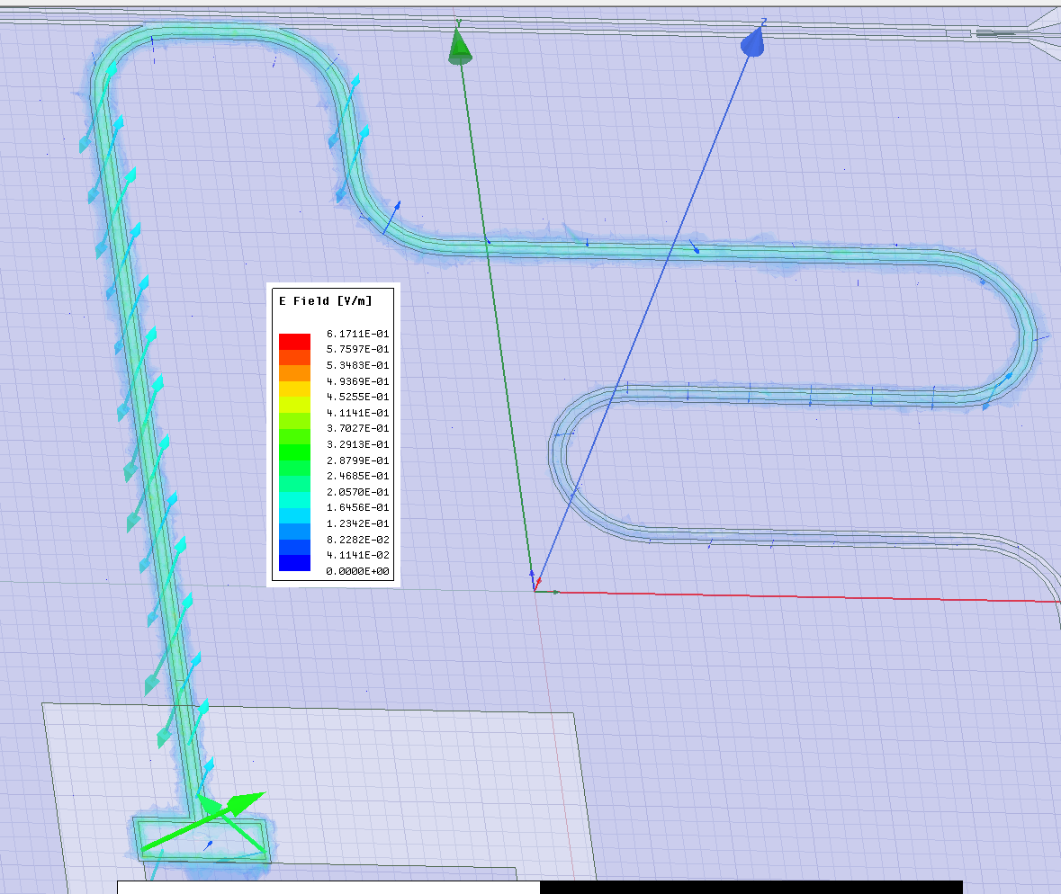



Planar chip 2D resonator → Flip chip 3D resonator
CPW
Qchip ground
CPW

Slide 13

Flip chip – Indium Bumps
Why Bumps
Bond quantum & control chip
Mechanical support
Galvanic connection to the respective ground planes
Bump condition
50~100/$1mm^{2}$
100~200$um$ spacing
Width=1.5*height
UBM thickness~10nm

Slide 14







 | Qubit (GHz) | Resonator(GHz) | Coupling g (MHz)
Planar chip | 5.81 | 7.05 | 114
Flipchip_7um Planar design | 4.78 | 7.54 | 20
Flipchip_7um modification | 5.88 | 7.20 | 114

Slide 15
Distance/ Bump O/X | Qubit (GHz) | Resonator(GHz) | Coupling g (MHz)
6um | 5.69/5.30 | 7.36/6.18 | 68
7um | (3.3%)5.88/5.56(4.9%) | (2.1%)7.20/6.45 | 11.8%76
8um | (2.6%)6.03/5.60(0.7%) | (1.4%)7.10/6.37 | 3.9%79
Distance/ Bump O/X | Qubit (GHz) | Resonator(GHz) | Coupling g (MHz)
6um | 5.66 | 7.18
7um | 5.82 | 7.02 | 74
8um | 6.00 | 6.91
Distance | Qubit (GHz) | Resonator (GHz) | Coupling g (MHz)
5um | 5.42 | 7.58 | 59
6um | 5.69 | 7.36 | 68
7um | 5.88 | 7.20 | 76
8um | 6.03 | 7.10 | 79
9um | 6.12 | 7.01 | 89

Slide 16
Parameter sensitivity
distance | Qubit (GHz) | Resonator(GHz) | Coupling g (MHz)
6um | 6.04 | 6.80 | 139
7um | 6.18 | 6.79 | 121
8um | 6.25 | 6.42 | 108
 | 1.72%/um | 2.79%/um | 11.84%/um
1um variation in d results in a 2.6% variation in qubit self-capacitance, 12% in coupling strength
Sandoko Kosen, Andreas Wallraff et al. Building Blocks of a Flip-Chip Integrated Superconducting Quantum Processor

Slide 17
Parameter sensitivity
Interchip spacing d plays an important role in determining the device parameters
1um variation in d results in a 2.6% varaiation in qubit self-capacitance, 12% in g
Tilt → component 마다 shift in opposite direction
xy misalignment
The titanium nitride under bump metalization (UBM) is used as a diffusion barrier between indium and aluminum as both are known to be very reactive metals
50-80nm titanium nitride film

